Slide 1
Mass Spectrum and Fourier Transform
modified from: Alexey I. Nesvizhskii

Slide 2
Learning Objectives
To learn about mass spectrum and how they can be used to identify peptide fragments
To learn about Fourier transform methods for analyzing mass spectrum

Slide 3
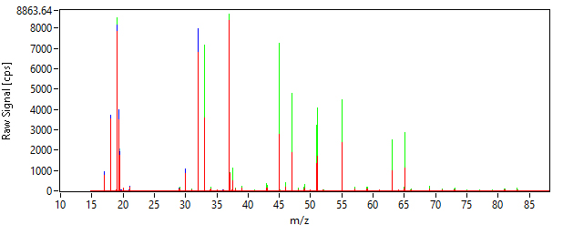
Mass Spectrum
A mass spectrum is the mass to charge ratio (m/z) plot from a chemical analysis
m is the mass, z is the charge
In proteomics, this m/z ratio represents the ions separated using a mass spectrometer, with the y-axis showing the overall abundance of each observation
Mass spectrum of the headspace of the sample of kiwifruit obtained using a PTR-TOF MS device
CC BY-SA 3.0: Wojciech Wojnowski

Slide 4
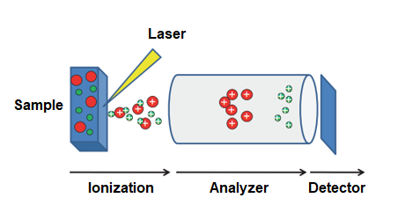
Matrix-assisted laser desorption/ionization (MALDI)
MALDI is a technique that ionizes large molecules using a laser absorbing matrix.
It has relatively lower fragmentation rate than other methods, resulting in larger intact molecules for assessment
Is typically linked with a particular MS method, e.g. MALDI-TOF
https://en.wikipedia.org/wiki/Matrix-assisted_laser_desorption/ionization

Slide 5
High Resolution Mass Spectrometry (HRMS)
HRMS allow for the detection of mass accurate enough to several decimal places, compared to lower resolution methods (LRMS)
For example, 2-octanone has a molecular weight of 128.12018 vs naphthalene which has 128.06264. A LRMS reporting 128 would thus be unable to distinguish between the two
There are three primary types of HRMS
Time of flight (TOF-MS)
Fourier transform ion cyclotron resonance mass spectrometers (FT-ICR-MS)
Orbitrap-MS

Slide 6
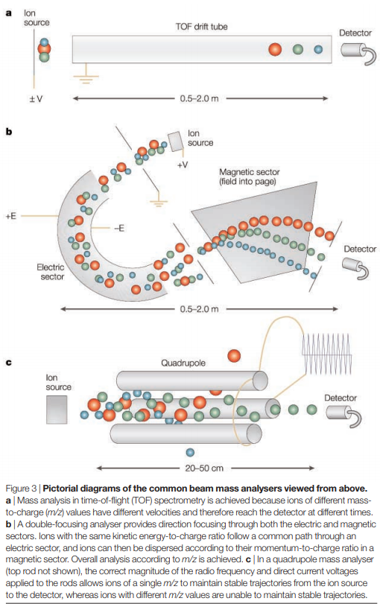
Time of flight (TOF-MS)
TOF-MS uses a time measurement to calculate an ion’s m/z.
Conceptually, the TOF separates ions based on their velocity and are excited at the same time
Ions with lower m/z charges are faster and vice versa

Slide 7
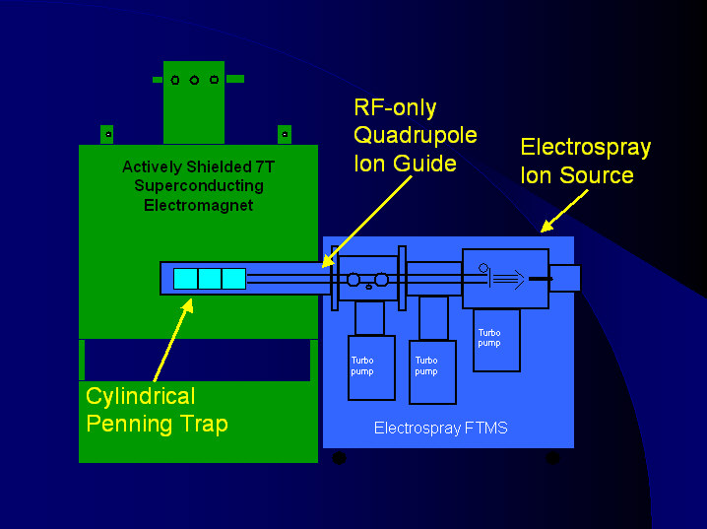

Fourier transform ion cyclotron resonance mass spectrometers (FT-ICR-MS)
Unlike TOF, FT-ICR-MS uses a magnetic field to determine the m/z of an ion.
This is done using an ion trap, captures charged particles. For FT-ICR-MS, a Penning Trap is typically used. This trap confines the charged particles which, when moving in a constant magnetic field, will exhibit cyclotron (angular) frequency
This frequency (w_{c})is a function of the magnetic field (B) and charge-to-mass ratio (q/m) [note difference in convention here]
https://www.bumc.bu.edu/ftms/modern-instrumental-biochemistry/ftms-introduction/

Slide 8
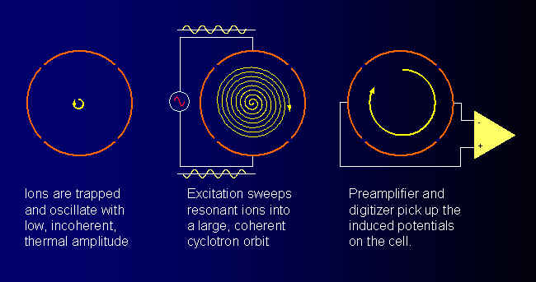
FT-ICR-MS Oscillation
After the ions are trapped in the cyclotron, they are excited into a circular orbit
Within this orbit, they will oscillate at the ion’s resonant frequency
https://www.bumc.bu.edu/ftms/modern-instrumental-biochemistry/ftms-introduction/

Slide 9
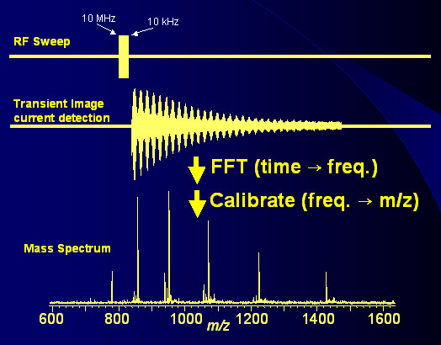
FT-ICR-MS Frequency
We expect to find many (all) ions in some known mass range, however.
To do this, we will need to sweep through all expected frequencies to excite the ions respectively.
This creates a periodic (time) function that can then be transformed into a spectrum (frequency) using a Fourier Transform
https://www.bumc.bu.edu/ftms/modern-instrumental-biochemistry/ftms-introduction/

Slide 10
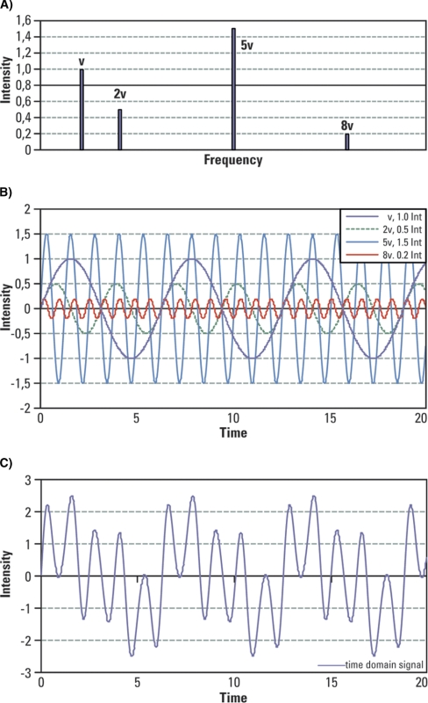

Fourier Transform
The Fourier transform operation converts the time domain signal into a complex spectrum.
Most MS applications use Fast Fourier Transform (FFT) which applies to Discrete Fourier Transform (DFT) and its inverse transform. Formally, DFT is defined as: where N = number of samples; n = current sample; x_{n} = value of signal at time n; i = imaginary number; k = current frequency (0 hz to N – 1 Hz); X_{k} = result of the DFT (amplitude and phase)
Specifically, the above equation will transform data from ‘time’ to ‘frequency’
Illustration of signal complexity encountered in FTMS. A, Four frequencies representing four different masses are considered here: frequency “v” of an intensity 1, frequency “2v” of an intensity 0.5, frequency “5v” of an intensity 1.5, and frequency “8v” of an intensity 0.2. B, Displayed waveforms for the considered intensities and frequencies. C, All four waveforms combined into a signal emulating the time domain signal detected by an FTMS.
Scigelova et al, Mol Cell Proteomics 2011

Slide 11
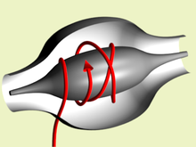
Orbitrap
Similar to FT-ICR-MS, ions are oscillated in an ion trap around a ‘barrel’-like electrode
However, Orbitrap uses electrostatic attractions between the inner and out electrodes to cycle the ions (compared to magnetic forces that FT-ICR uses)
These oscillations are then captured and converted to mass spectrum using FFT
https://en.wikipedia.org/wiki/Orbitrap

Slide 12
Advantages/Disadvantages of different MS methods
TOF-MS can achieve mass resolution up to 60,000 (at m/z 200) while Orbitrap can do much higher (240,000) and over 1,000,00 for FT-ICR-MS
High mass accuracy allows for direct sample infusion
Higher resolution is also much slower
TOF-MS has a higher tolerance to salts and other contaminants
Each approach is fairly complementary and may be more appropriate depending on the question being asked

